Slide 1
INSTALLING & CONFIGURING SERVERS

Slide 2
Windows Server Migration Tools

Slide 3
Overview
Windows Server Migration Tools
Supported operating systems
Supported Editions
Installing Windows Server Migration Tools
Points to Ponder

Slide 4
Windows Server Migration Tools
Administrators can use Windows Server Migration Tools to migrate server roles, features, operating system settings, and other data and shares to computers that are running Windows Server

Slide 5
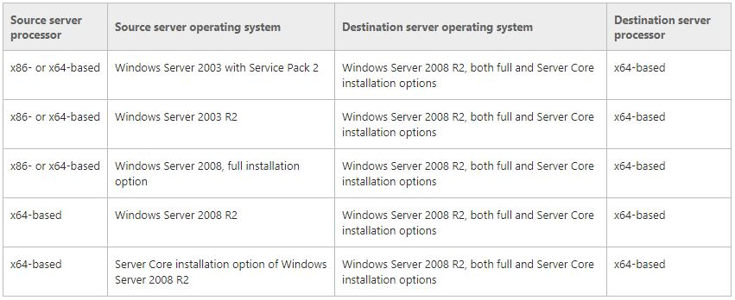
Supported operating systems

Slide 6
Supported Editions
The following editions of Windows Server are supported as either source or destination servers:
Windows Server Foundation
Windows Server Standard
Windows Server Enterprise
Windows Server Datacenter

Slide 7
Installing Windows Server Migration Tools
There are 2 way of installing these tools on your Windows Server 2012 server.
Powershell
Add Roles and Features Wizard

Slide 8
Installing Windows Server Migration Tools (Contd.,)
Using Powershell
Use PowerShell by opening a Windows PowerShell command window as administrator.
Install-WindowsFeature Migration –ComputerName

Slide 9
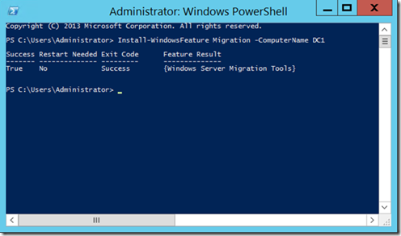
Installing Windows Server Migration Tools (Contd.,)
Fig: Installing Windows Server Migration Tools via Powershell

Slide 10
Installing Windows Server Migration Tools (Contd.,)
Using Add Roles and Features Wizard
Use the “Add Roles and Features Wizard” to add the Windows Server Migration Tools to your destination machine.

Slide 11
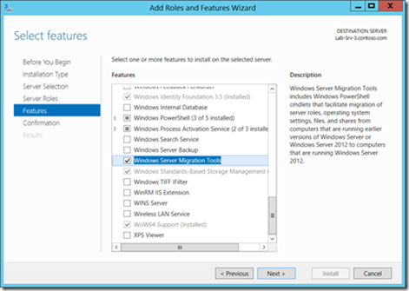
Installing Windows Server Migration Tools (Contd.,)
Fig: Installing Windows Server Migration Tools via Add Roles and Features Wizard

Slide 12
Points to remember…
When using the Windows Server Migration Tools, it is important to understand the following points:
You should be familiar with using PowerShell and Server Manager.
Features must be installed on both source and destination computers.
Source operating system must be at least Windows Server 2003 (x86 or x64).
Server Core 2008 R2 is supported as a source operating system.
The destination will support Server 2012 R2 full and Core (x64) installation options.
Supports both physical and virtual servers.
Migration between different language installations is not supported.

Slide 13
Thank you

